Slide 1
DAT Class 6
Extracting, Merging, Grouping

Slide 2
Numpy & Pandas: An Introduction
Overview
Give students a brief but coherent overview of Numpy & Pandas, plus the role they serve in the python ecosystem
Important Note
Be prepared to handle issues with installation here.
Learning Objectives
In this lesson, students will:
Get their Jupyter notebook up and running
Introduce students to IPython computing environment
Introduce students to numpy arrays & pandas dataframes
Duration
45 min - 1 hour

Slide 3
Suggested Agenda
Time | Activity | Purpose
0:00 - 0:15 | Anaconda Download + Installation | Getting everyone’s install correct, introduction to Jupyter notebook
0:16 - 0:30 | Numpy Introduction | Discuss students the important details of what makes numpy unique, its role in data science ecosystem
0:31 - 0:45 | Pandas Introduction | What it does, how it interacts with numpy, what dataframes are.
0:46 - 0:50 | Summary | Finish this portion of the lesson by having students

Slide 4
Materials and Preparation
Time spent on this lesson might be highly variable depending on how difficult a time people have with getting their operating environment up and running.
Besides getting everyone’s Jupyter Notebook up and running, focus on making sure everyone has a broad conception about what makes numpy & pandas unique, and how they interact with one another
Wrap this lesson up by using pd.read_csv() to load in a dataframe

Slide 5
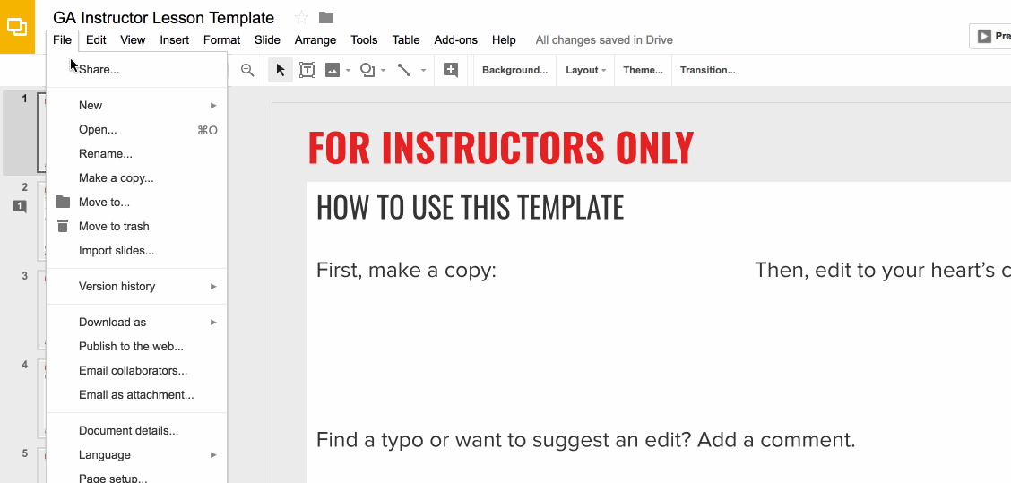
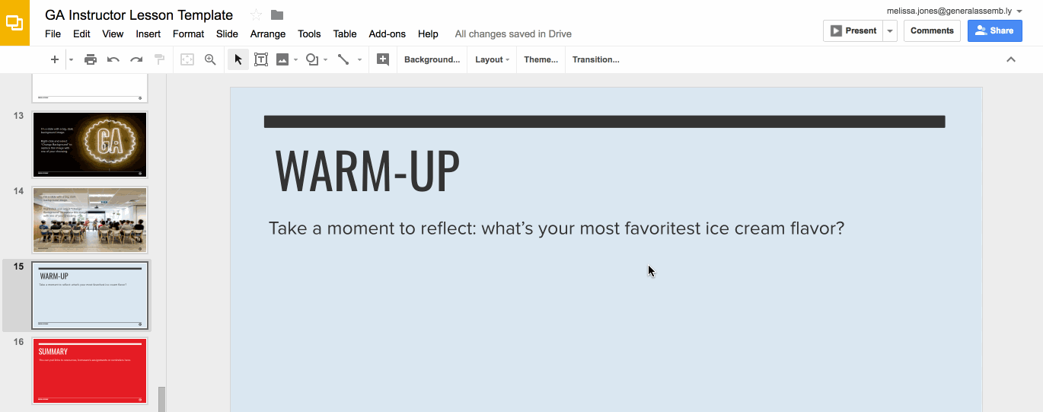
Preparation (Continued)
Ready to customize this lesson?
First things first, make a copy of this presentation. You’ll then be able to edit to your 💗’s content.
Find a typo or want to suggest an edit?
Add a comment. Our Product Advisory Board will review and incorporate your suggestions.

Slide 6

Preparation (Continued)
Remember to press Command F and do a search for instances of brackets in the deck. All instances of brackets denote places where instructors must fill in information/customize prior to presenting in class.

Slide 7
Differentiation and Extensions
This is a suggestion for a way in which instructors might change up this lesson to meet the needs of more advanced or less advanced students.
This is another suggestion.
This is another suggestion.
Be sure to link to any supplemental/optional materials on this slide.

Slide 8
Creating and Manipulating Data in Pandas
Python For Data
Notes:
X MINUTES
TALKING POINTS
This is a suggested talking point.
This is another.
TEACHING TIPS
This is a suggestion for the instructor on something to do before, during or after presenting this slide.
This is another suggestion.

Slide 9
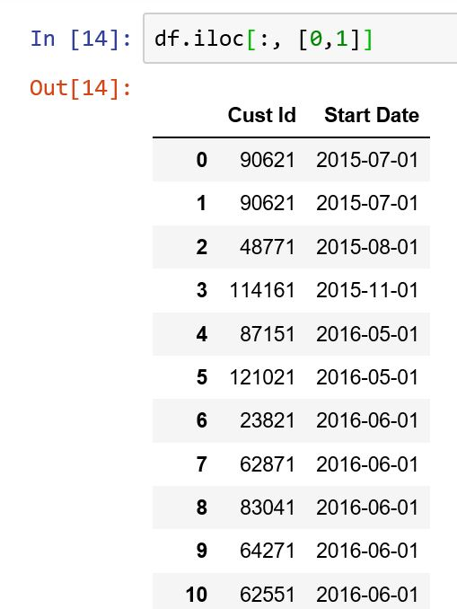
Pandas: Creating Data
Variables are manipulated using vectorized code
Means you basically treat columns and datasets as a single variable
A bit different from regular Python: no loops!
Notes:
3-5 MINUTES
TALKING POINTS
After this slide, go back to Jupyter notebook and demonstrate different querying techniques:
Selecting based on one condition
Selecting with AND/OR keywords
How to select individual columns with queries

Slide 10
Pandas: Creating Data
You can think of pandas methods for creating data falling into two categories: general and particular.
3 general methods:
np.where()
np.select()
df.apply()
Notes:
3-5 MINUTES
TALKING POINTS
After this slide, go back to Jupyter notebook and demonstrate different querying techniques:
Selecting based on one condition
Selecting with AND/OR keywords
How to select individual columns with queries

Slide 11
Pandas: Creating Data
np.where():
Simple way to create if/else statement to create new variables
np.select():
Advanced version of np.where() - can create multiple conditions
Notes:
3-5 MINUTES
TALKING POINTS
After this slide, go back to Jupyter notebook and demonstrate different querying techniques:
Selecting based on one condition
Selecting with AND/OR keywords
How to select individual columns with queries

Slide 12
Pandas: Creating Data
Methods for specific ways of changing data:
pd.cut() – turn a numeric category into predefined bins
df.map() – change values in a column from one to another
df.replace() – replace specific values with something else
Notes:
3-5 MINUTES
TALKING POINTS
After this slide, go back to Jupyter notebook and demonstrate different querying techniques:
Selecting based on one condition
Selecting with AND/OR keywords
How to select individual columns with queries

Slide 13
Section 1 of Lab
Take 10-12 minutes and complete section I of the accompanying lab.

Slide 14
Merging Data
Python For Data
Notes:
X MINUTES
TALKING POINTS
This is a suggested talking point.
This is another.
TEACHING TIPS
This is a suggestion for the instructor on something to do before, during or after presenting this slide.
This is another suggestion.

Slide 15
Pandas: Merging Data
Pandas allows you to combine multiple dataframes together
Very similar to UNION and JOIN in SQL
Corresponding methods are:
df.merge
pd.concat
Notes:
3-5 MINUTES
TALKING POINTS
After this slide, go back to Jupyter notebook and demonstrate different querying techniques:
Selecting based on one condition
Selecting with AND/OR keywords
How to select individual columns with queries

Slide 16
Pandas: Merging Data
df.merge():
- similar to JOIN
- important arguments:
- on: column to join on
defaults to joining on every column
can also choose subsets
- how: how to do the JOIN/merge:
inner, outer, left, right
- left_on/right_on: which columns to use for each dataframe
- left_index/right_index: set to True if you want to merge on index
Notes:
3-5 MINUTES
TALKING POINTS
After this slide, go back to Jupyter notebook and demonstrate different querying techniques:
Selecting based on one condition
Selecting with AND/OR keywords
How to select individual columns with queries

Slide 17
Section 2 of Lab
Take 10-12 minutes and complete section II of the accompanying lab.

Slide 18
Grouping Data
Python For Data
Notes:
X MINUTES
TALKING POINTS
This is a suggested talking point.
This is another.
TEACHING TIPS
This is a suggestion for the instructor on something to do before, during or after presenting this slide.
This is another suggestion.

Slide 19
Pandas: Grouping Data
You can *squash* data into discrete categories to get summary statistics for different levels within a particular column.
Similar to GROUPBY in SQL or pivot tables in Excel
Two primary ways you do this in pandas:
Groupby(): the name says it all
Resample: Allows you to group using continuous time
Notes:
3-5 MINUTES
TALKING POINTS
After this slide, go back to Jupyter notebook and demonstrate different querying techniques:
Selecting based on one condition
Selecting with AND/OR keywords
How to select individual columns with queries

Slide 20
Pandas: Grouping Data
You can *squash* data into discrete categories to get summary statistics for different levels within a particular column.
Similar to GROUPBY in SQL or pivot tables in Excel
Two primary ways you do this in pandas:
Groupby(): the name says it all
Resample: Allows you to group using continuous time
Notes:
3-5 MINUTES
TALKING POINTS
After this slide, go back to Jupyter notebook and demonstrate different querying techniques:
Selecting based on one condition
Selecting with AND/OR keywords
How to select individual columns with queries

Slide 21
Pandas: Grouping Data
A pandas groupby statement has the following characteristics:
Columns that you are grouping on:
Can be either single values or a list
Columns that you are selecting from your groupby object
Aggregators that you are returning
Can either be pre-specified or custom
Can be single or multiple
Notes:
3-5 MINUTES
TALKING POINTS
After this slide, go back to Jupyter notebook and demonstrate different querying techniques:
Selecting based on one condition
Selecting with AND/OR keywords
How to select individual columns with queries

Slide 22
Pandas: Grouping Data
Resampling:
Similar to groupby, except it allows you to apply it to continuous time.
Gives you the ability to define a fairly particular time sequence to view data on. Complete list is here: http://bit.ly/date-offsets
Notes:
3-5 MINUTES
TALKING POINTS
After this slide, go back to Jupyter notebook and demonstrate different querying techniques:
Selecting based on one condition
Selecting with AND/OR keywords
How to select individual columns with queries

Slide 23
Section 1 of Lab
Take 10-12 minutes and complete section III of the accompanying lab.

